Slide 1
Syntax-Directed Translation Schemes
Syntax-Directed Translation schemes are a complementary notation to Syntax Directed Definitions.
A syntax-directed translation scheme (SDT) is a context free grammar with program fragments embedded within production bodies.
The program fragments are called semantic actions and can appear at any position within a production body.
The underlying grammar is LR-parsable, and the SDD is S-attributed.
The underlying grammar is LL-parsable, and the SDD is L-attributed.

Slide 2
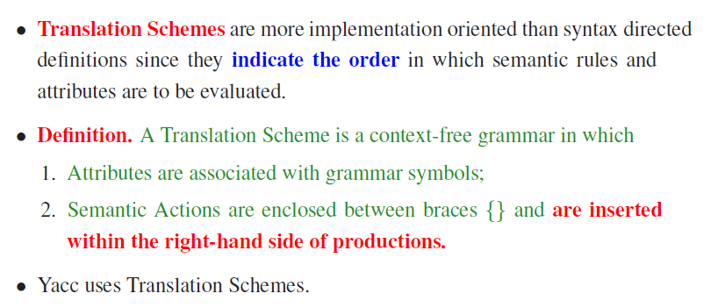
Syntax-Directed Translation Schemes

Slide 3
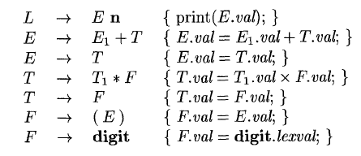

Postfix Translation Schemes
SDT's with all actions at the right ends of the production bodies are called postfix SDT's.

Slide 4
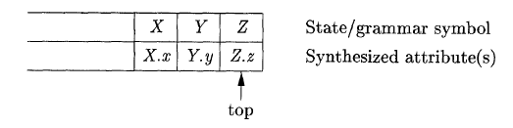
Parser-Stack Implementation of Postfix SDT's
Postfix SDT's can be implemented during LR parsing by executing the actions when reductions occur.
For production A → X YZ

Slide 5
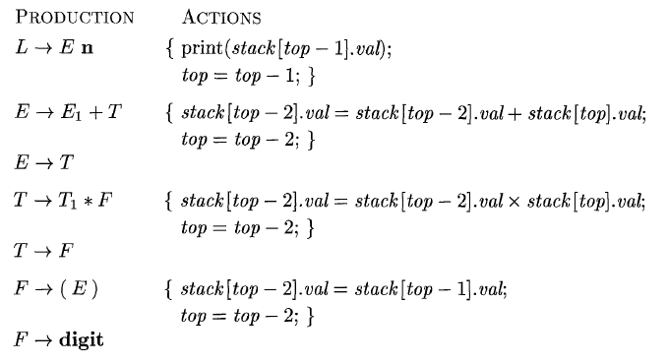
Implementing the desk calculator on a bottom-up parsing stack
* The stack is kept in an array of records called stack, with top a cursor to the top of the stack.
* stack[top] refers to the top record on the stack, stack[top - I] to the record below that, and so on.

Slide 6
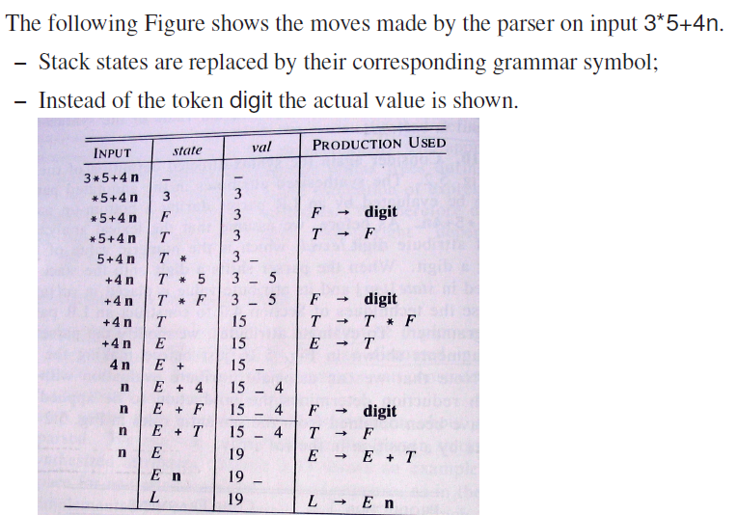
Parser Stack Implementation for Postfix SDT

Slide 7
Write Postfix SDT for the S-Attributed Definition for converting binary to decimal
Production | Semantic Rules
D→ D1B | D.val=D1.val*2 + B.val
D→B | D.val=B.val
B→0 | B.val=0
B→1 | B.val=1
SDT
D→ D1B {D.val=D1.val*2 + B.val}
D→B {D.val=B.val}
B→0 {B.val=0}
B→1 {B.val=1}

Slide 8
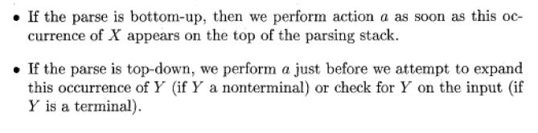
SDT's With Actions Inside Productions
An action may be placed at any position within the body of a production.
It is performed immediately after all symbols to its left are processed.
For a Production B→ X {a} Y
The action a is done after we have recognized X (if X is a terminal) or all the terminals derived from X (if X is a nonterminal) .

Slide 9
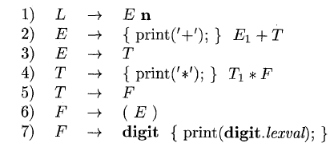
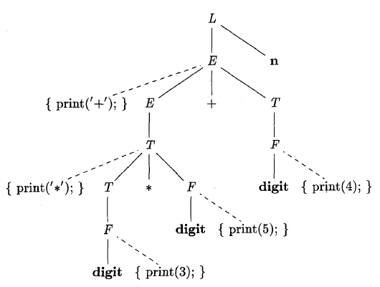
SDT that prints the prefix form of an expression
SDT for infix-to-prefix translation during parsing
Parse tree with actions embedded
Parse tree for expression 3 * 5 + 4 with actions inserted
If we visit the nodes in preorder, we get the prefix form of the expression: +* 3 5 4

